Slide 1

The Cord Image Search
Vaibhav Singh
Megha Pujamath

Slide 2
Agenda
Project Description
Design Diagram
Dataset
Data cleaning
Bulk indexing
Features/Queries implemented

Slide 3
Project Description
"Build a Figure search engine using Elastic Search to index the references and captions extracted from Electronic Thesis and Dissertation(ETD) figures from CORD dataset and build a search interface that returns ETD tables and figures"

Slide 4
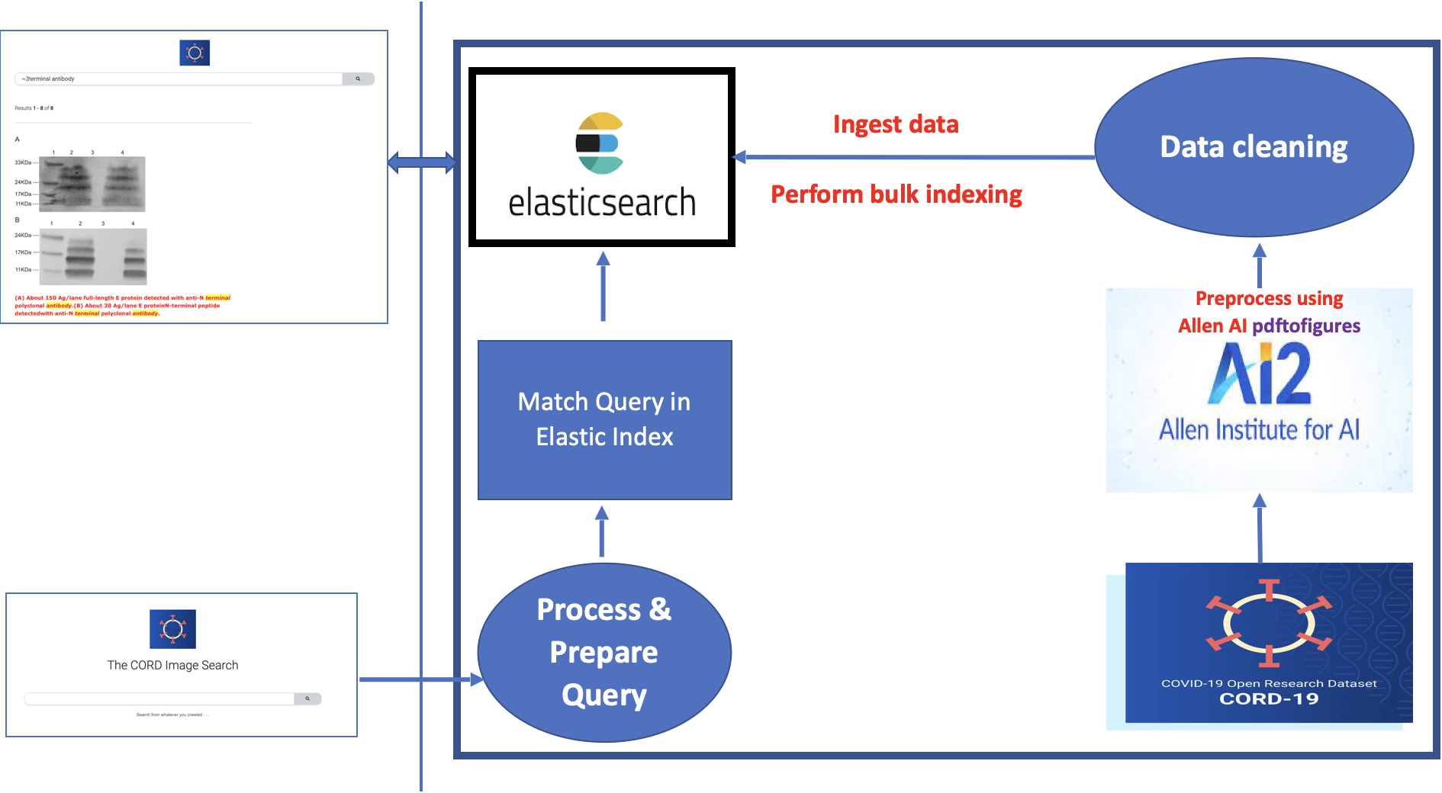
Design Diagram

Slide 5
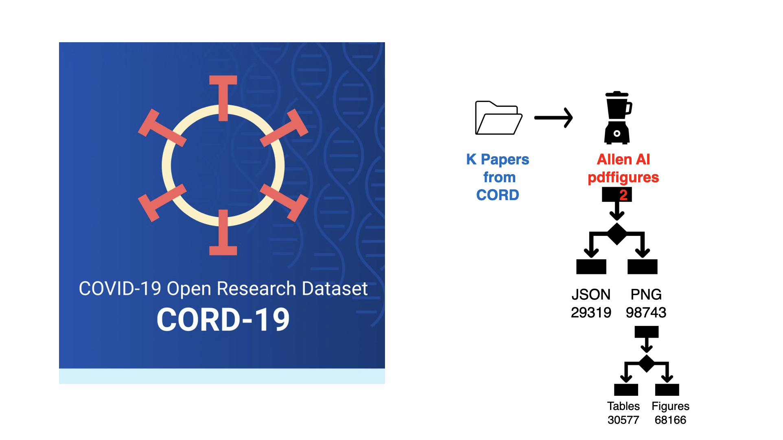
Dataset Exploration
CORD Dataset : Corpus of academic papers about COVID-19 and related coronavirus research

Slide 6
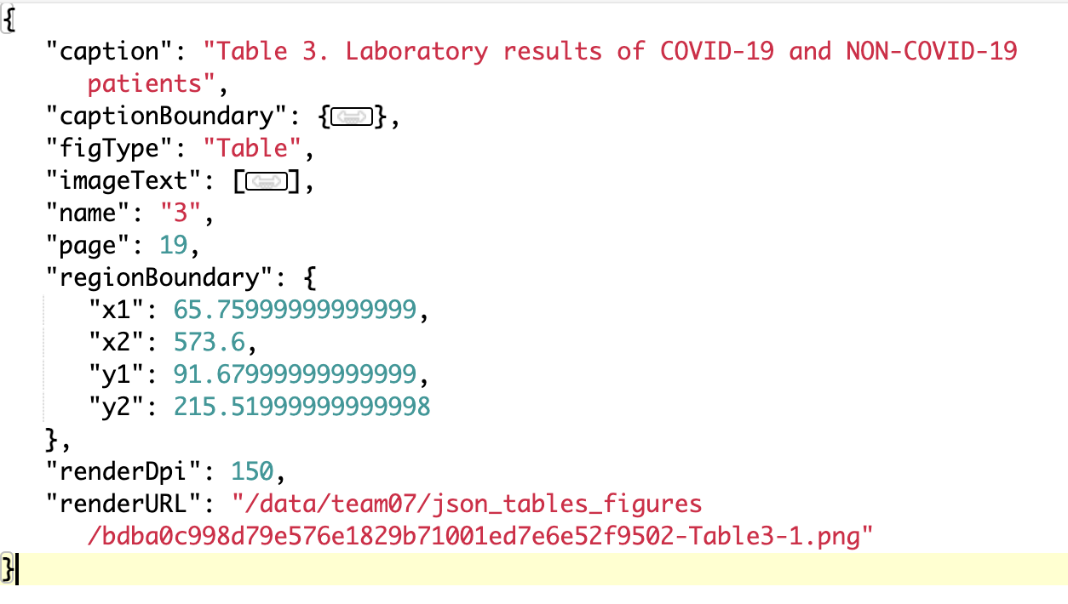
Data Cleaning

Slide 7



Bulk Indexing
https://github.com/mradamlacey/json-to-es-bulk
JSON 1
Bulk format JSONs
JSON 1
Bulk format JSONs
JSON
Bulk format JSONs
{"index":{"_index":"cord_index","_type":"embeddings"}}
Actual JSONified document
HTTP/1.1 413 Request Entity Too Large
curl -v -H 'Content-Type: application/json' - XPOST ' http://localhost:9200/cord_index/_bulk' --data-binary @combined.txt
Indexing API
Merged Bulk format Data
elasticsearch.yml
http.max_content_length: 500mb

Slide 8

Features Implemented

Slide 9
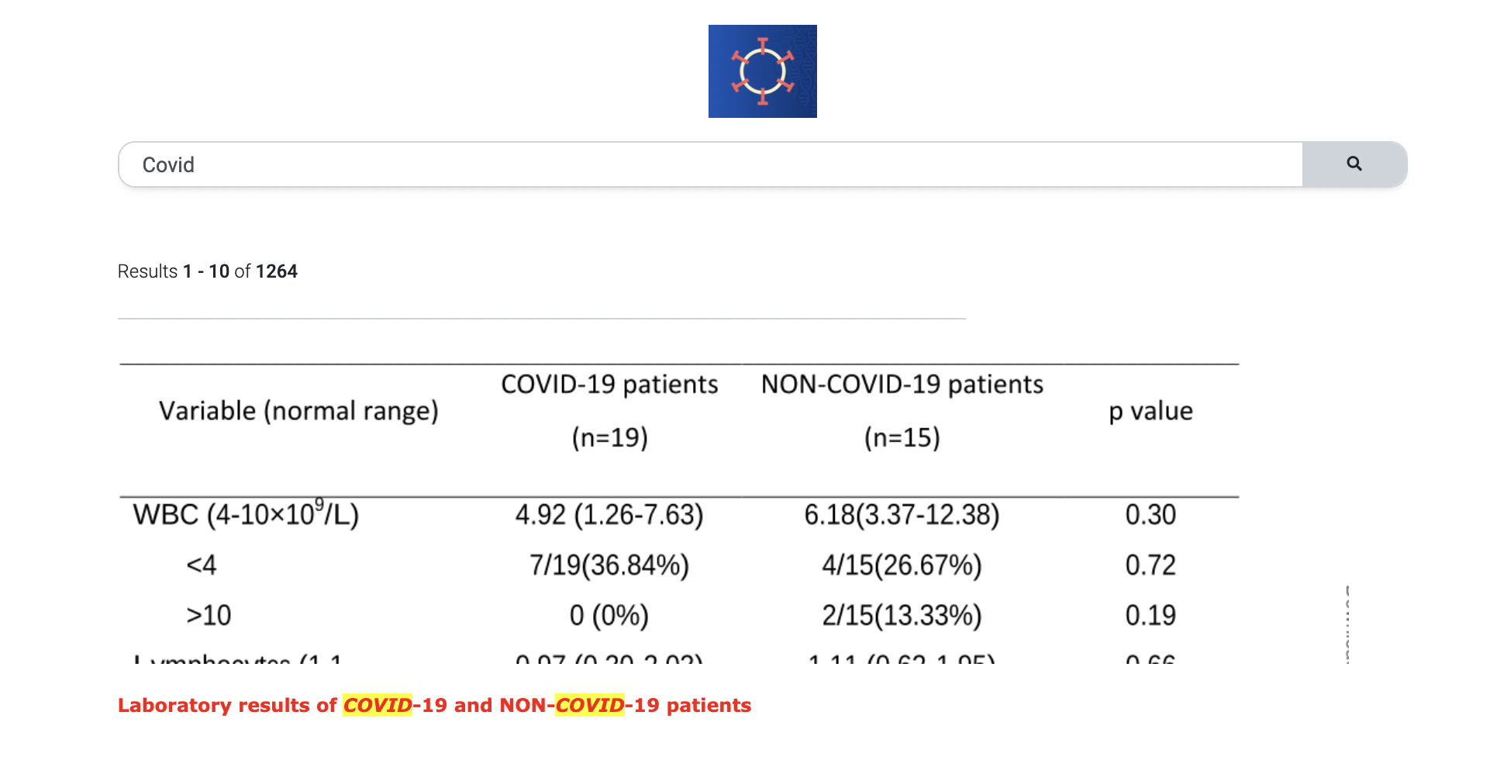
Basic match query
"query": {
"multi_match" : {
"query" : nquery,
"fields" : ["caption^10", "imageText"], #boosting here
}
}

Slide 10
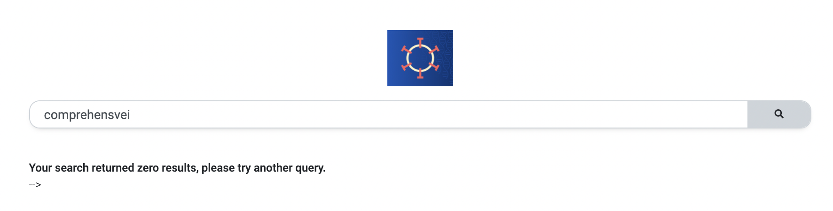
Query Without Fuzziness

Slide 11
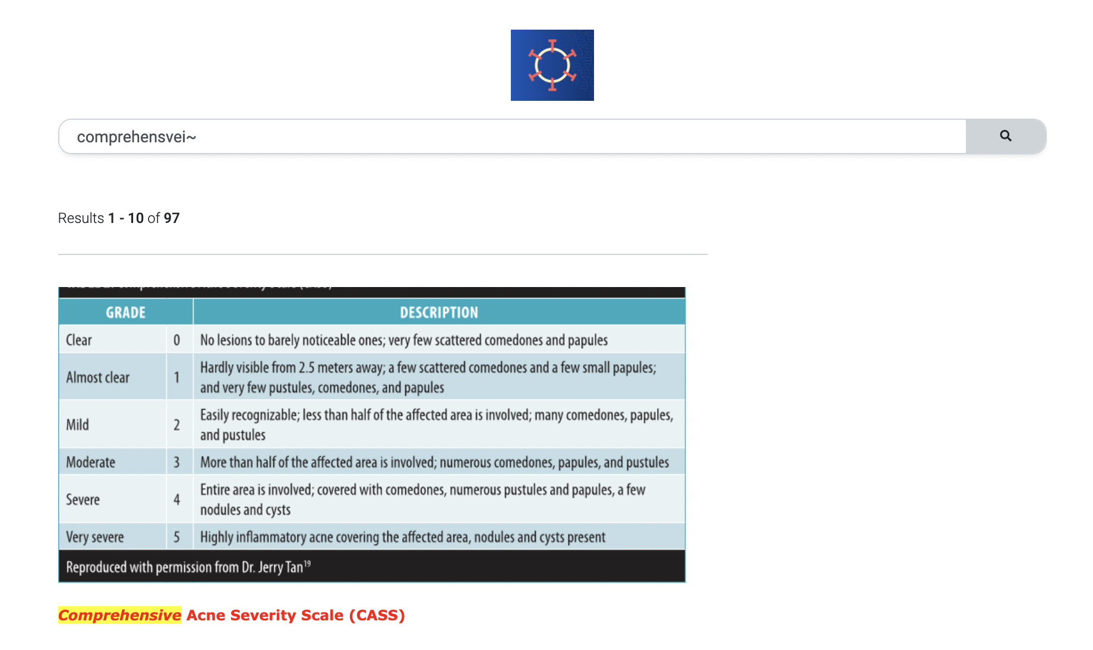
"query": { "multi_match" : { "query" : nquery, "fields" : ["caption^10", "imageText"], "fuzziness": "AUTO", } }
Query with Fuzziness

Slide 12
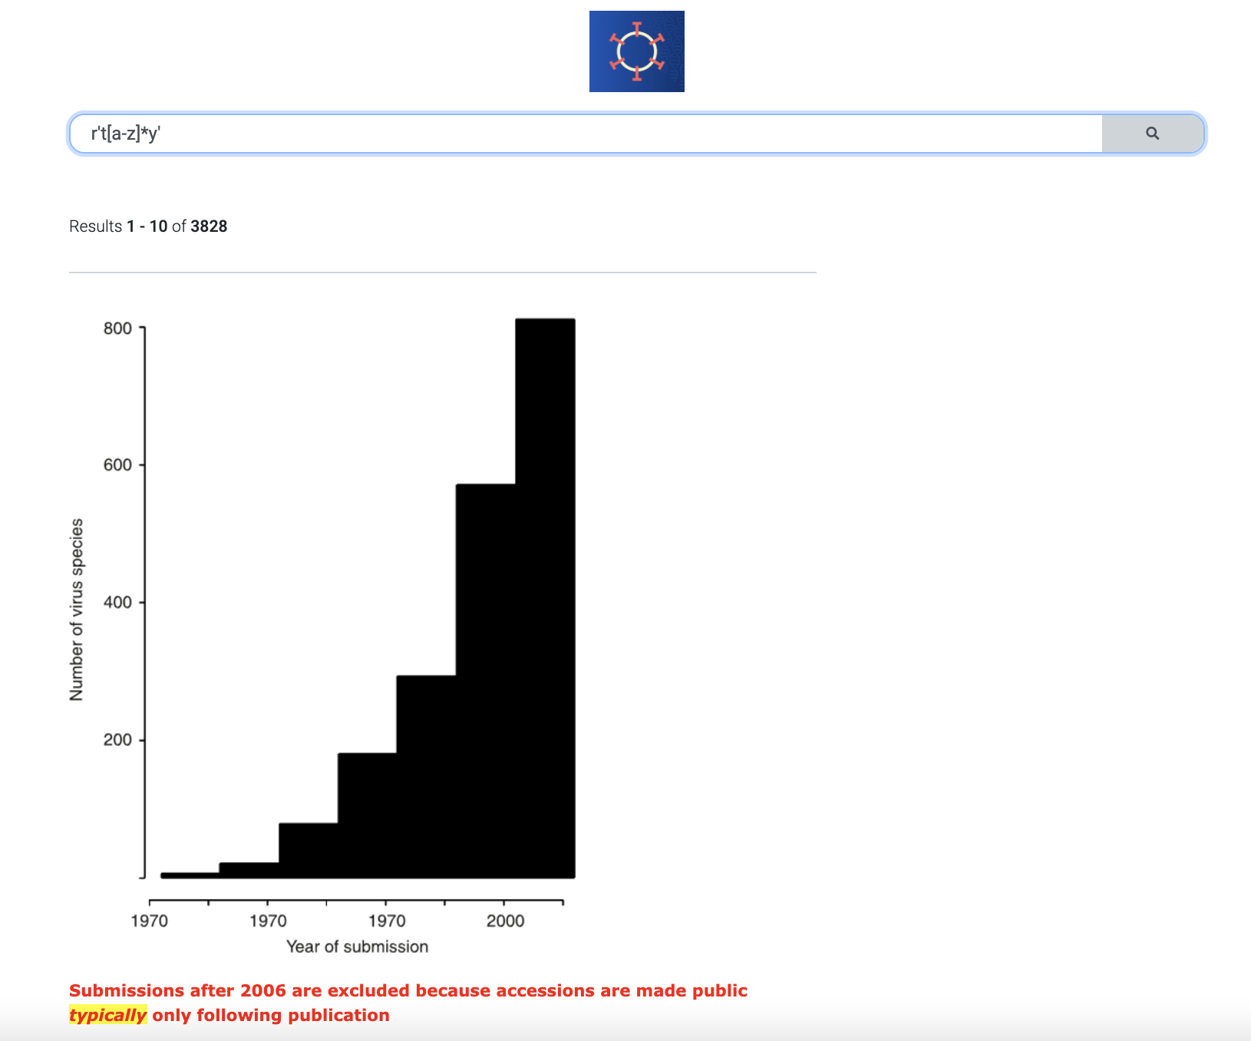
"query": { "regexp" : { "caption" : nquery } }
Regex Query

Slide 13
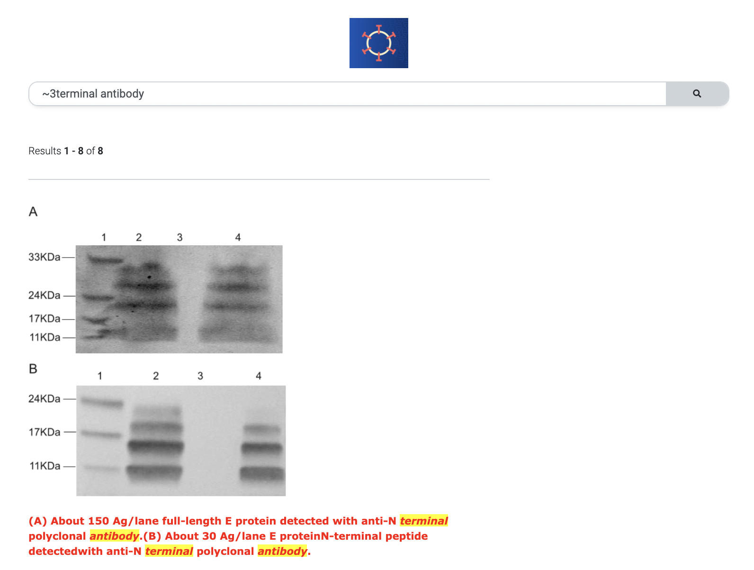
"query": { "match_phrase": { "caption": { "query": nquery, "slop": phrase_slop }, } }
Match Phrase Query

Slide 14
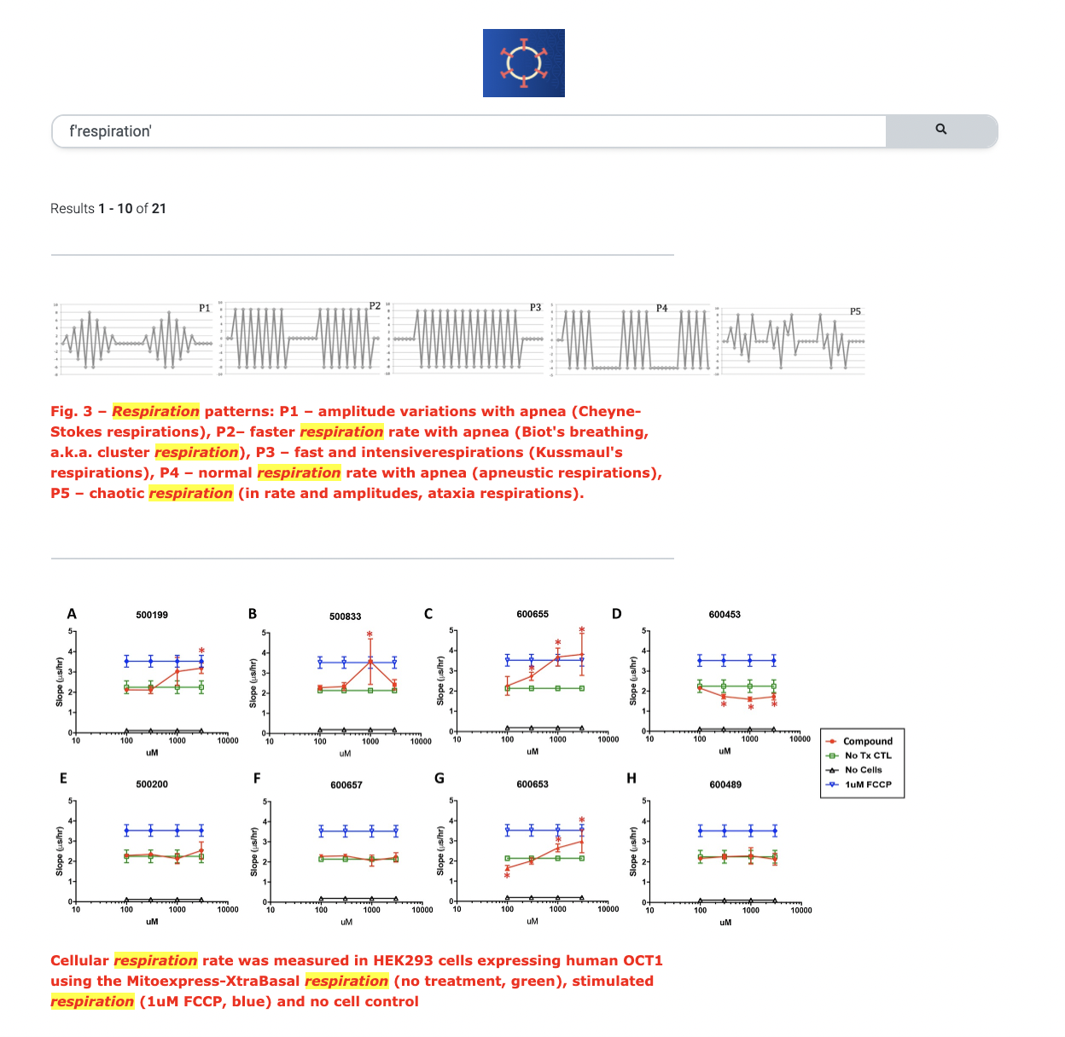
"query": { "bool": { "must": [ { "match": { "figType": "Figure" } }, { "multi_match" : { "query" : nquery, "fields" : ["caption", "imageText"], #boosting here } } ] } }
Query to search across Figures

Slide 15
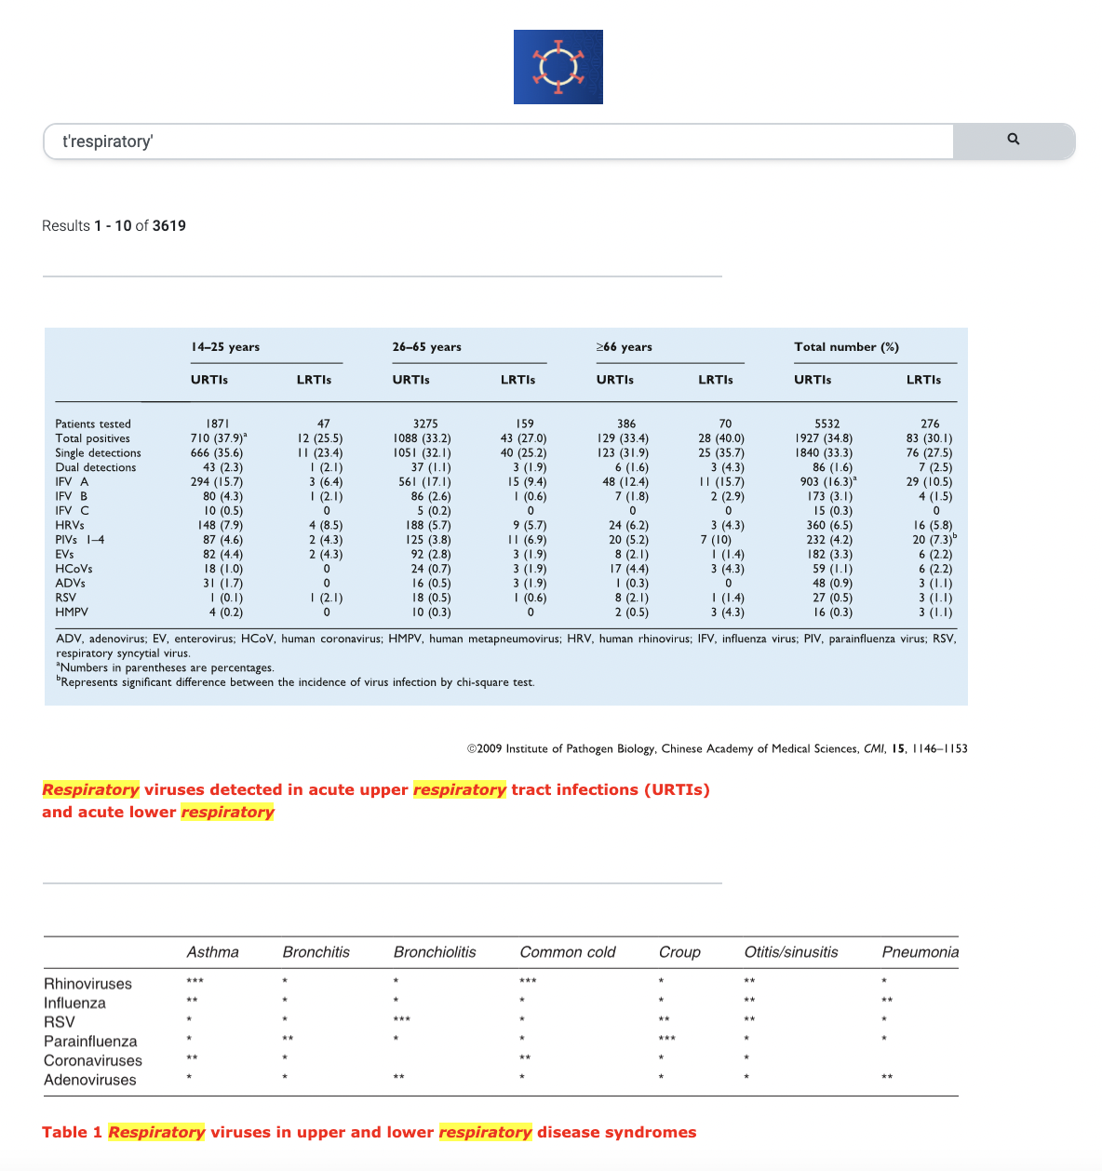
"query": { "bool": { "must": [ { "match": { "figType": "Table" } }, { "multi_match" : { "query" : nquery, "fields" : ["caption", "imageText"], #boosting here } } ] } }
Query to search across Tables

Slide 16

Demo

